Slide 1

Ashland Daily Photo
http://traveljapanblog.com/ashland/2012/08/portland-oregon-from-the-air/

Slide 2
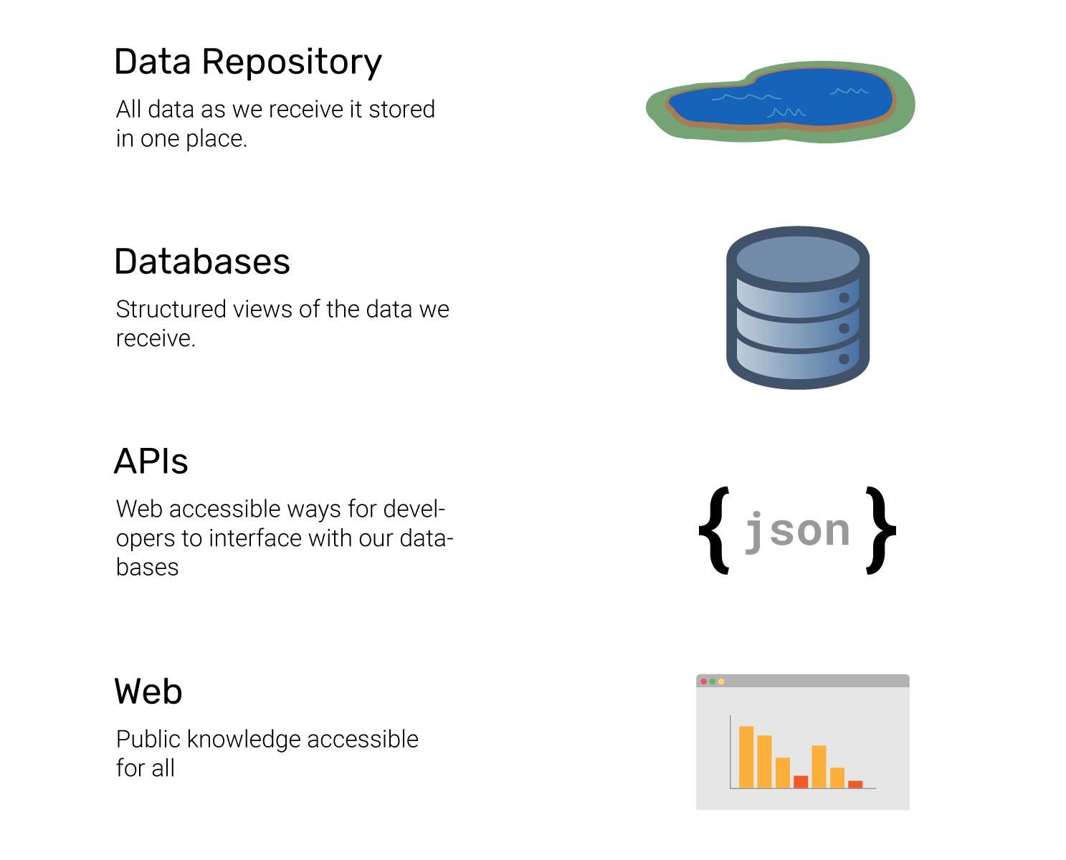

Slide 3
Learn PostGres the Hack Oregon Way

Slide 4
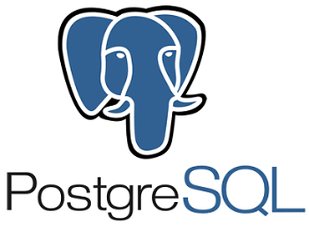

Slide 5
High-level takeaways
Features of PostGres
CRUD & Loading Data
Performance
Other Tools
Security
PostGIS
PostGres at HackOregon

Slide 6
Postgres or PostGreSQL?
Originally named POSTGRES for (Post Ingres)
Project and product named PostgreSQL
Pronounced “post gress queue ell”
SQL can be pronounced “ess queue ell” or “sequel”

Slide 7
Industry Trends
Backend frameworks (Apache/PHP, Ruby on Rails, Django)
Work with any database (MySQL/MariaDB, SQLite, PostgreSQL)
Use the database for CRUD, application logic is all in PHP / Ruby / Python / JavaScript code

Slide 8
Features of Postgres
Industrial-strength open source permissive-licensed CRUD engine
Fully ACID compliant
Scales to huge installations
Replication / failover / high availability as standard equipment
Full-text search
Stored procedures in Python, Perl, Ruby, R, Tcl and Lua
JSON document stores (jsonb)
Key-value stores (hstore)
Foreign data wrappers. Access to external data sources from within the Postgres database. (Note: We don’t use this on AWS RDS)
Notes:
(Atomicity, Consistency, Isolation, Durability) is a set of properties of database transactions intended to guarantee validity even in the event of errors, power failures, etc.
In the context of databases, a sequence of database operations that satisfies the ACID properties (and these can be perceived as a single logical operation on the data) is called a transaction

Slide 9
Hack Oregon Page in Github
https://github.com/hackoregon/disaster-resilience/wiki/Tools-For-Hack-Oregon

Slide 10
Installation - Windows or Mac
Download from here: https://www.PostgreSQL.org/download/
Select the most recent version (11.3)
Select your operating system (Windows or Mac)

Slide 11
Installation - *NIX
Linux: use the PGDG repositories
RHEL / CentOS / Fedora: https://www.PostgreSQL.org/download/linux/redhat/
Linux Mint 18 / Ubuntu 16.04 LTS ("Xenial"): https://github.com/hackoregon/data-science-petcontainers/blob/master/docs/Mint18-Xenial/README.md
Debian: https://www.PostgreSQL.org/download/linux/debian/

Slide 12
pgAdmin
A free and open-source graphical user interface (GUI) administration tool for PostgreSQL
Installation https://www.pgadmin.org/download/

Slide 13
Connecting with pgAdmin - Windows
Connecting with pgAdmin - (R. Obe and Hsu 2017b, chap. 4)
  Right-click on "Servers"
  Create a server
  Give it any name you want
  Fill in the connection tab
EnterpriseDB connection
  Host: localhost
  Port: 5432
  Maintenance database and user are Postgres
  Password is what you set when you installed

Slide 14
Connecting with pgAdmin - Linux
Linux connection (at least on Mint / Ubuntu)
Host: /var/run/PostgreSQL
Port: 5432
Maintenance database and user are the same as your Linux ID
Password is empty
Follow the steps here for setup: https://github.com/hackoregon/data-science-pet-containers/tree/master/old-docs/Mint18-Xenial

Slide 15
CRUD - Create / Read / Update / Delete
SQL is set-based
Relational database model
Most implementations, everything is data
  Schema
  Procedures
  Users
  Extensions
  etc.

Slide 16
Create
Creating
  Database (pgAdmin)
  View
  Column
  Functions
  Events
  Triggers
Create table
Creating tables - Data Definition Language (DDL)
Working with tables, you need to do two things:
  Define the names and data types of every column in the table.
  Load the data into the table.

Slide 17
Create
We’ll be working with a sample file of Oregon highway mileposts
https://github.com/hackoregon/data-science-pet-containers/blob/master/examples/mileposts/Mileposts_2014
Tip: If you don’t know a field’s data types, you can always just set them all to text and re-cast them to the correct type with SQL later!
In this case it’s mostly obvious which columns are numeric or timestamps, and we can use text for the rest.
For the mileposts, we’ll use double precision for the latitude and longitude and text for the others.

Slide 18
Create
The DDL
CREATE TABLE mileposts_2014 (
hwyname text,
hwynumb text,
st_hwy_sfx text,
rdwy_id text,
mlge_typ text,
ovlp_cd text,
mp text,
mp_desc text,
mp_disp text,
lrs_key text,
lrm_key text,
lat double precision,
longtd double precision,
hrz_col_m text,
crd_rf_dtm text,
effectv_dt text,
gis_prc_dt text);

Slide 19
Naming in Postgres
A tip on naming:
PostgreSQL requires special care in coding SQL queries when column names have anything besides lower-case letters, numbers or underscores.
If the table, view or role has a hyphen or capital letter it needs to have double-quotes.
It’s a real hassle, so snake_case rules!

Slide 20
Loading Data
Loading the data into the table:
psql \copy
psql is the command-line PostgreSQL client.
Fully scriptable - you can write programs in it
Has string substitution.
You can mix SQL statements and psql commands.
It’s great for reproducibility But it’s another language to learn. Most folks may prefer to script in a language they know, like Python, which has its own PostgreSQL client libraries.

Slide 21
Data Types
char(10) - fixed length
varchar(255) - variable-length
text - variable-length
integer - 4-byte integer that has a range from -2,147,483,648 to 2,147,483,647.
float - floating point precision
numeric - real number
date - date
timestamp - date & time
json - json
boolean - true / false
And more...

Slide 22
Read (query)
SELECT, TABLE, WITH -- retrieve rows from a table or view
Select statement
Where
Join
Order by
;

Slide 23
Read Example
select *
from public.mileposts_2014
where hwyname = 'KINGS VALLEY'
order by mp_disp;

Slide 24
Update
ALTER TABLE -- change the definition of a table
UPDATE -- update rows of a table

Slide 25
Update Examples
alter table public.mileposts_2014 add column source_file varchar(255);
update public.mileposts_2014 set source_file = 'Mileposts_2014.csv';

Slide 26
Delete
DELETE -- delete rows of a table
DROP TABLE -- remove a table
TRUNCATE -- empty a table or set of tables

Slide 27
Delete Examples
delete from
public.mileposts_2014
where
hwyname = 'CLACKAMAS';
alter table public.mileposts_2014 drop column source_file;

Slide 28
Aggregates
AVG( [ DISTINCT | ALL ] expression)
COUNT(*)
COUNT( [ DISTINCT | ALL ] expression )
MAX( [ DISTINCT | ALL ] expression)
MIN( [ DISTINCT | ALL ] expression)
SUM( [ DISTINCT | ALL ] expression)
Example:
select count(*)
from public.mileposts_2014
where hwyname = 'KINGS VALLEY’

Slide 29
Views
Join
Subqueries
Returning Aggregates

Slide 30
Performance - Optimization
Rule of Optimization:
Make it work
Make it right
Make it fast enough

Slide 31
Performance - Indexes
Primary keys are indexes
In large tables, consider adding indexes to any fields that will be searched, joined or sorted.
An index which covers multiple columns is generally better than creating multiple indexes for a single column.
PostgreSQL will consider using a multi-column index even if some of the columns in the index are not even used in the query.
For example if we had the following index:
create index order_dates on orders(creation_date, completion_date);
It can be used for queries using any combination of the creation_date and completion_date column. The benefit of having fewer indexes is that they might live in the shared memory, and caches, for a longer time.
Indexes (usually) have a minimal effect on the size of the db.
They can slow down inserts.

Slide 32
Performance - Query Tools
Explain — show the execution plan of a statement
https://www.PostgreSQL.org/docs/current/sql-explain.html
You can do this in pgAdmin
Analyze - collect statistics about a database
https://www.PostgreSQL.org/docs/current/sql-analyze.html

Slide 33
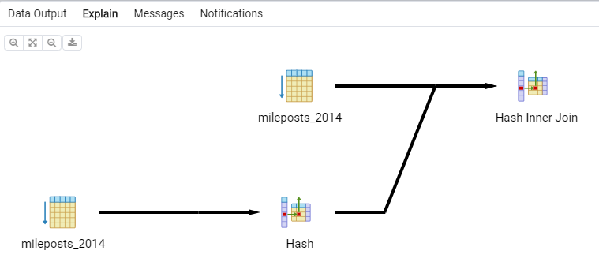
Explain - Example Output
Select
A.hwyname, B.hwyname, A.mp
From public.mileposts_2014 as A
join public.mileposts_2014 as B on B.mp = A.mp
Where A.hwyname = 'KINGS VALLEY'

Slide 34
Performance - Materialized Views
Materialized views
Queries returning aggregate, summary, and computed data are frequently used in application development, but sometimes these queries are not fast enough. The simplest way to improve performance is to use a materialized view.
A materialized view is a snapshot of a query saved into a table.
CREATE MATERIALIZED VIEW
https://www.PostgreSQL.org/docs/9.3/sql-creatematerializedview.html
Because it's a table, you can create indexes and use those efficiently.
Warning: this can increase the size of the database.
More about materialized views: https://hashrocket.com/blog/posts/materialized-view-strategies-using-PostgreSQL

Slide 35
Performance - Considerations
Do more in the database. - More efficient than pulling over many rows and then working in the front end.
Production is different than on the desktop, so test production.
Ref: This page has a lot of suggestions for perf. Tips https://dev.to/elmuerte/improving-PostgreSQL-queries-4pc1

Slide 36
Psql
Psql - Psql is the interactive terminal for working with Postgres. http://Postgresguide.com/utilities/psql.html
psql --version
sudo -u Postgres psql - Log into PostgreSQL on your computer. Login as default user "Postgres" with password password_of_your_ubuntu_system:
sudo -u role_name psql db_name - Log in directly into a database as a user from the terminal (with password as password_of_your_ubuntu_system).

Slide 37
Psql - Key Commands
\l - List the available databases
\du - List all users in PostgreSQL
\c database_name - Connect to a db via the default user
\c database_name user_name - connect to db with a specific user
\q - Exit out of psql
\d - List all tables in psql
\dt - listing the available tables in the current database
\d <table name> - Describe schema of a table
SELECT version(); - show version of Postgres
\g - show command history
\? - listing all the available commands
\h <command> - help on a specific command
\timing - turn on timing for inspecting query performance

Slide 38
Backup & Restore - Backup
use pg_dump to make a backup of a database (pgAdmin live)
Q: What’s the best way to dump the schema definition?
A: pgdump can be used for dumping everything, or selectively dump.
(FYI, pgdump can be called from pgAdmin: right-click on database and choose “Backup”)
Q: What if I want to export code to create the tables in a new database?
A: pgdump --format=p
eg:
\pg_dump.exe --host localhost --port 5432 --username "Postgres" --no-password --format plain --verbose --file "C:\temp\export-me2.backup" "Postgres"

Slide 39
Backup & Restore - Restore
Restoring a database: pg_restore (pgAdmin live)
Tip: When restoring a dump, restore it without the owner

Slide 40
Security - General
Default Postgres port is 5432 and username Postgres.
By default, the owner of any database you create is Postgres.
If you want your database to belong to a specific user, switch to that user and then create the database.

Slide 41
Security - Users & Roles
Change the default port & user name on a server (or even on a desktop) to avoid hackers cracking your password.
Consider restricting listen_address to localhost on a desktop.
Logins / roles are set at the database server level.
Grant permissions:
grant SELECT on public.mileposts_2014 to "ima-readonly-user";

Slide 42
Security - AWS
On a desktop, you’re usually the database superuser. Everything works, and your machine’s behind a firewall.
On a server, there’s a DBA and a SysAdmin that hand out privileges only with justification. You don’t get it unless you need it, and everything you do is logged and monitored. Bottom line: don’t be surprised if you get told, "No! Find another way."

Slide 43
PostGIS
PostGIS cool features
  Geographic Information Systems (GIS)
  Read and write GIS data files
  Process geometric, geographic and topology GIS data types
  Both vector and raster data
  Geocoding, reverse geocoding, address standardization
Open Source route planning libraries (OSRM and pgRouting)
  Shortest / fastest / lowest cost routes from point A to point B
  Traveling salesperson problem
  Turn-by-turn directions for cars, bikes and pedestrians!

Slide 44
PostGIS - Installation
PostGIS will be included in the container deployed on AWS in production
To install the extensions in your database

Slide 45
Postgres in Docker Containers
Usually Debian stable - similar to Ubuntu
Sometimes Alpine - avoid this unless you want to do a lot of research
Ed has a full PostgreSQL / PostGIS / pgRouting stack in a container at https://github.com/hackoregon/data-science-pet-containers

Slide 46
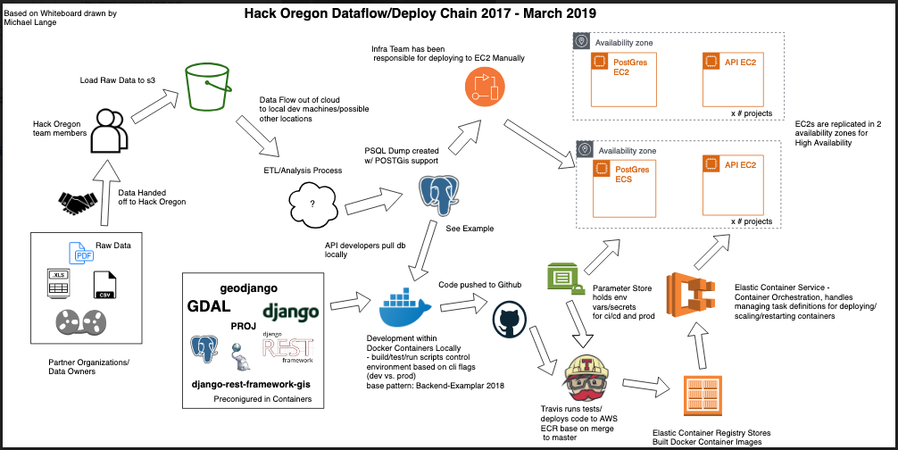
Postgres at Hack Oregon

Slide 47
Postgres at Hack Oregon
Open Source
We host in AWS RDS which provides a managed environment
Deploying databases from S3 through jumpbox to RDS

Slide 48
Postgres at Hack Oregon
Best practices
Track schema changes in code under revision in git.
Use Django migrations to alter schema
Include small datasets in the migrations
  eg: lookup tables
  Data that helps with processing
Load large datasets from source data (that is in a shared repository)
Data transformations?
  Use views to simplify & aggregate data
  Or, preprocess from static database and then load only the refined data

Slide 49
Postgres at Hack Oregon
The (data) cycle of life: (proposed)
Make code/schema changes in the models
Migrate model changes to the local database
Load data into local database
  Or, use Fixtures to do some data migrations
Backup to a dump file
Restore dump file to production
Deploy code changes. Database schema changes have already been deployed

Slide 50
Thanks to Ed
Ed Borasky’s Postgres orientation for Hack oregon 2018 season
“Getting Started with PostgreSQL M. Edward (Ed) Borasky 2019-04-30”
https://github.com/hackoregon/data-science-pet-containers/blob/master/old-docs/getting-started-with-PostgreSQL.pdf

Slide 51
More Information
Postgres documentation
https://www.postgresql.org/docs/
Postgres free books, cheap books:
https://www.packtpub.com/packt/offers/free-learning
PgRouting: A Practical Guide. Locate Press LLC.
https://locatepress.com/pgrouting
PostgreSQL: Up and Running, 3rd Edition. O’Reilly Media, Inc.
http://shop.oreilly.com/product/0636920052715.do
PostGIS in Action, Second Edition. Manning Publications Co. https://www.manning.com/books/postgis-in-action-second-edition

Slide 52
Thank you!

